Slide 1
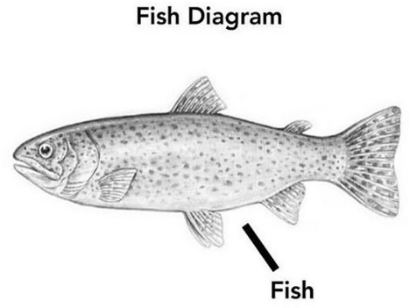
ME COMMENTING MY CODE

Slide 2
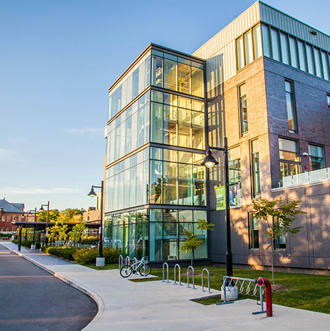

Adam Thomas
Professor, Media Studies and IT Faculty of Media and Creative Arts adam.thomas@humber.ca codeadam.ca
Gary Bhanot
gaurav.bhanot@humber.ca pixelr.io

Slide 3
Pillars of a Programming Language
Syntax
Data Types
Variables
Control Structures
Functions and Methods
Input Output Operations
Error Handling
Libraries and Frameworks

Slide 4
1. Server Side vs. Client Side

Slide 5
URL Breakdown
Understanding a URL is crucial:
http://www.domain.com/folder/file.html?variable=value&variable2=value2#anchor
Protocol: http://, https://, ftp://
Domain: www.domain.com, sub.domain.com
Folder: /services/
File: index.html, home.php
Variables: ?variable=value&variable2=value2
Anchor: #home, #top
Note: ? represents the end of the URL and the beginning of the variables
Note: & divides each individual variable

Slide 6
Client Side Language
Client-side scripting generally refers to the class of computer programs on the web that are executed client-side, by the user's web browser, instead of server-side (on the web server).
Client Side Language. (n.d.). Wikipedia, Retrieved September 19, 2016, from https://en.wikipedia.org/wiki/Client-side_scripting

Slide 7
Server Side Language
Those scripts were executed by the operating system, and the results were served back by the web server. Many modern web servers can directly execute on-line scripting languages such as ASP, JSP, Perl, PHP and Ruby either by the web server itself or via extension modules (e.g. mod_perl or mod_php) to the web server.
Server Side Language. (n.d.). Wikipedia, Retrieved September 19, 2016, from https://en.wikipedia.org/wiki/Server-side_scripting

Slide 8
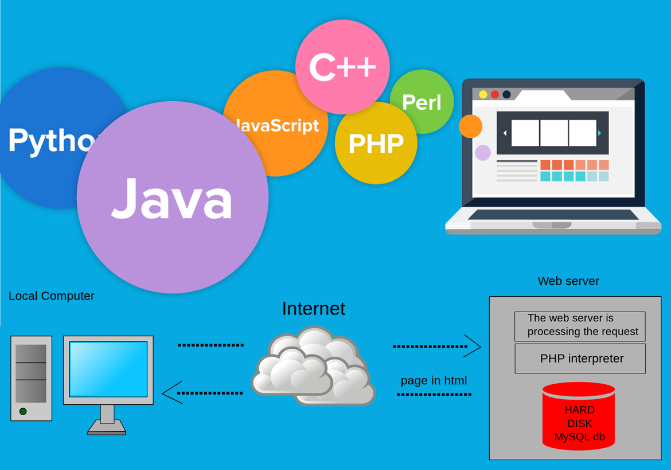
Client Side vs. Server Side Language
https://jayanta1.hashnode.dev/the-distinction-between-server-side-and-client-side-development-in-web-development

Slide 9
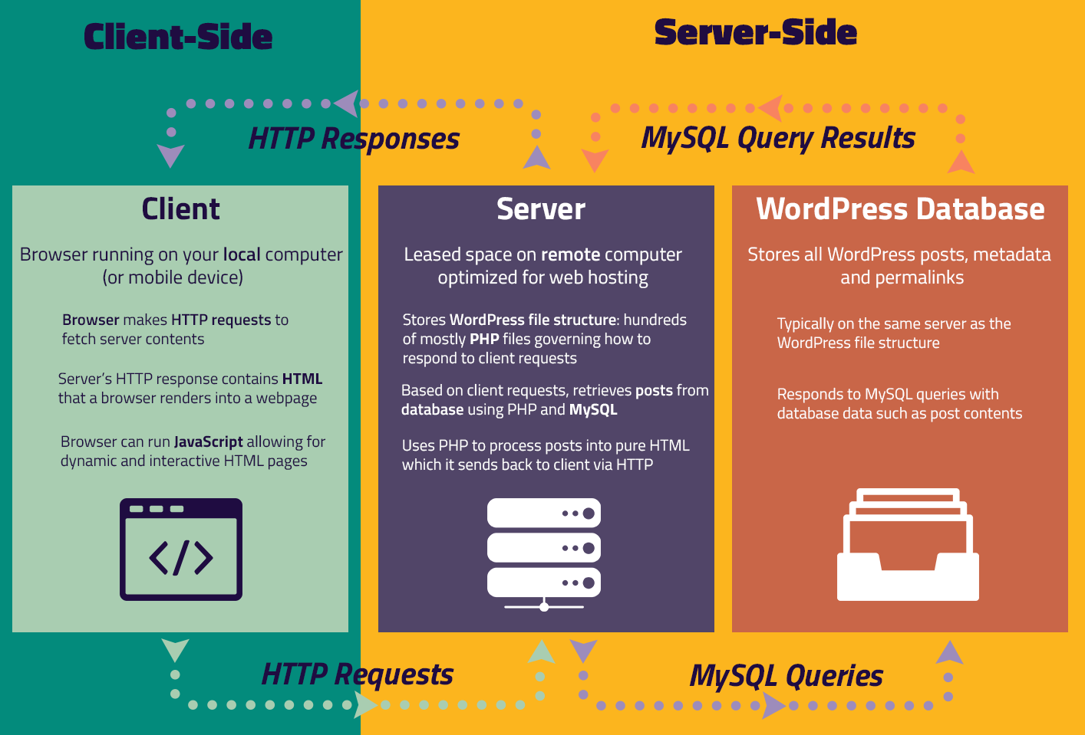
https://jayanta1.hashnode.dev/the-distinction-between-server-side-and-client-side-development-in-web-development

Slide 10
CSR – The Diner’s Perspective
Imagine you're at a restaurant, seated at a beautifully set table. The menu is like the client-side – it's in your hands, and you can make choices instantly.
When you decide to order, you interact with the waiter (your browser) who takes your request and relays it to the kitchen (the server) for preparation.
The kitchen then sends back the finished dish directly to your table (the client), ready for you to enjoy.
In this analogy, the dining experience is smooth, quick, and personalized – much like how client-side programming provides immediate user interactions and responses.

Slide 11
SSR – Behind the Kitchen Doors
On the other hand, server-side programming is like the bustling kitchen of the same restaurant. This is where the chefs (server-side scripts and databases) work their magic.
They receive orders from multiple tables, prepare the dishes, handle cooking complexities, and ensure everything runs smoothly behind the scenes.
The waiter (browser) doesn't bring the raw ingredients (data) to your table; instead, they go to the kitchen to get the final, prepared meal.
In this analogy, the kitchen represents the server-side processes, hidden from the diners (clients), handling the behind-the-scenes complexity of data processing, storage, and business logic.

Slide 12
2. Creating Output

Slide 13
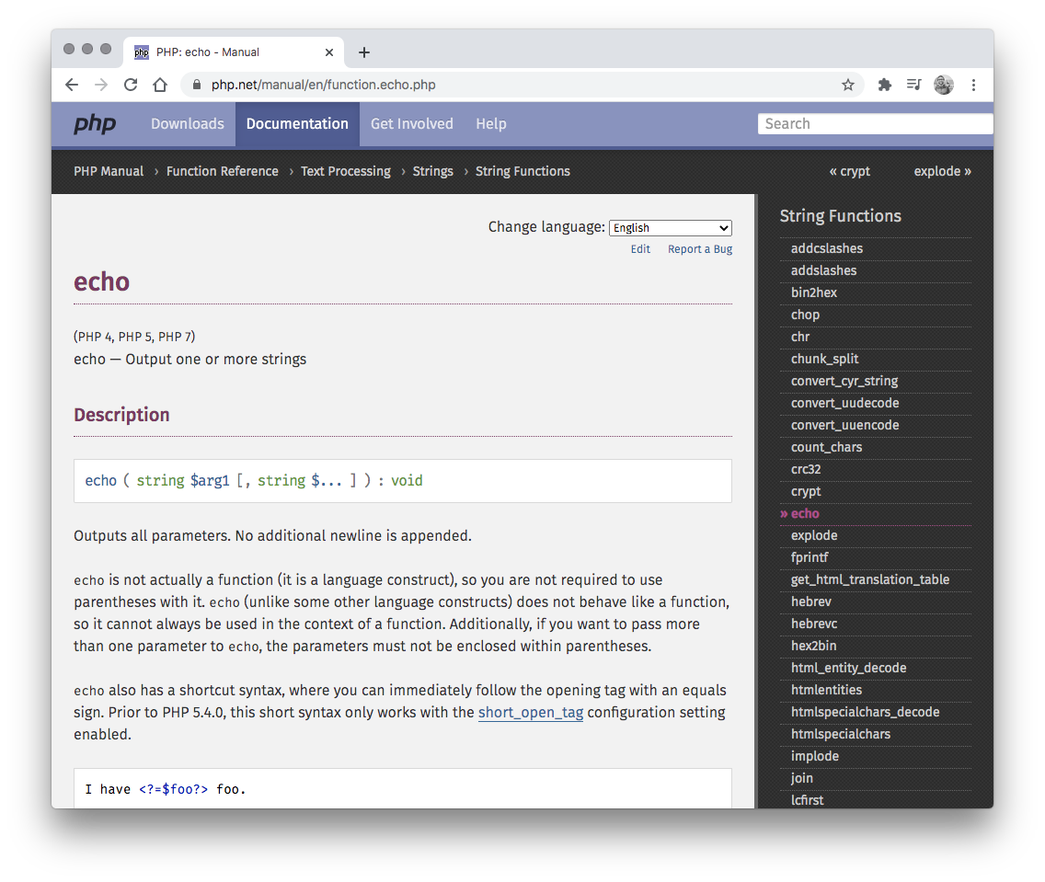
Creating Output
PHP uses echo or print to create output:
<?php echo "Hello World!"; echo '<p>Hello World!</p>'; echo "<p> Hello World! </p>";
?>
https://www.php.net/manual/en/function.echo.php

Slide 14
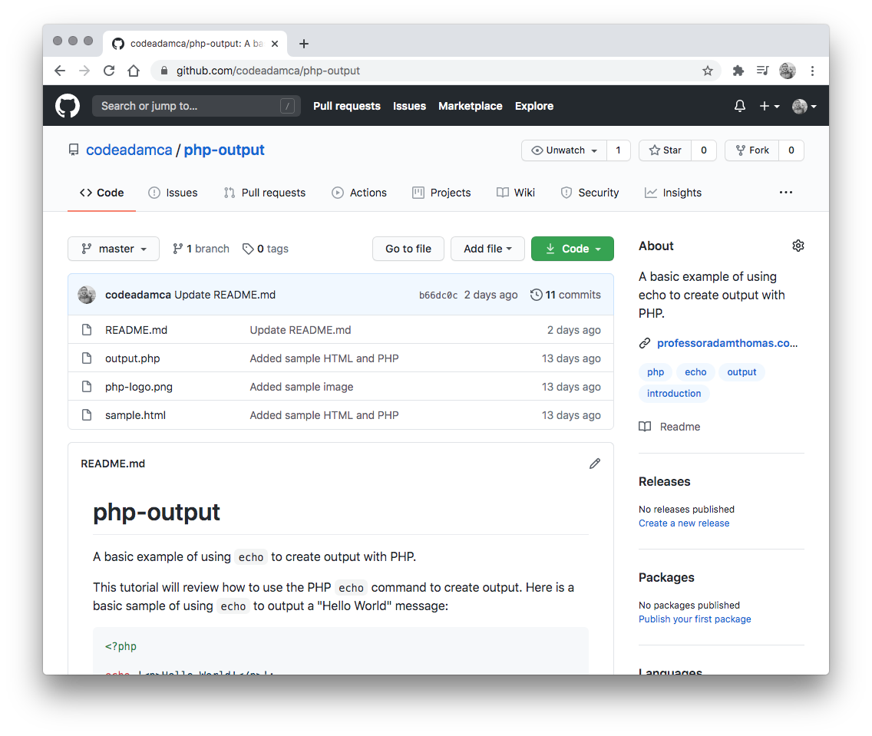
PHP Output Exercise
Follow the output exercise on GitHub:
https://github.com/codeadamca/php-output

Slide 15
3. Using Variables

Slide 16
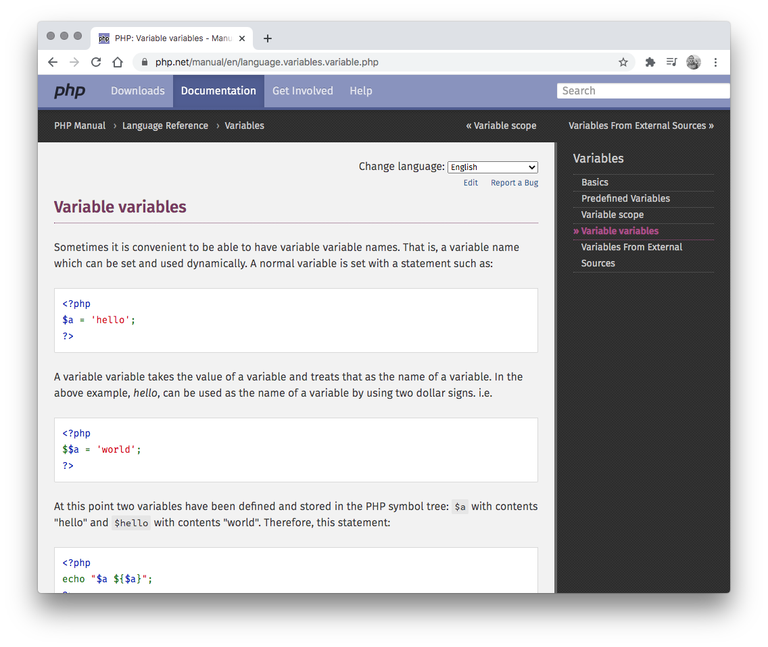
Variables
PHP variables are used for storing data:
<?php
$text = "Hello world!";
$number = 5;
?>
https://www.php.net/manual/en/language.variables.variable.php

Slide 17
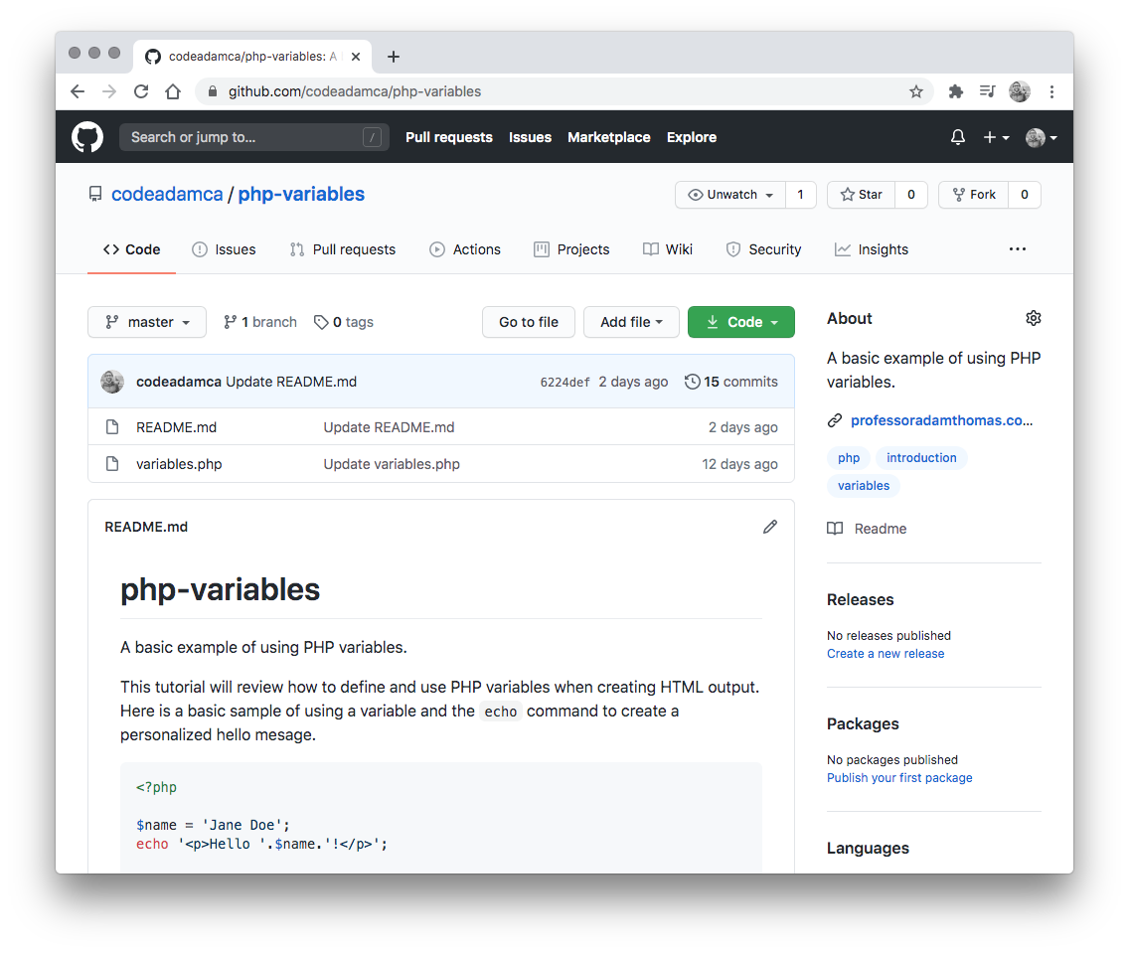
PHP Variables Exercise
Follow the variables exercise on GitHub:
https://github.com/codeadamca/php-variables

Slide 18
4. Using Arrays

Slide 19
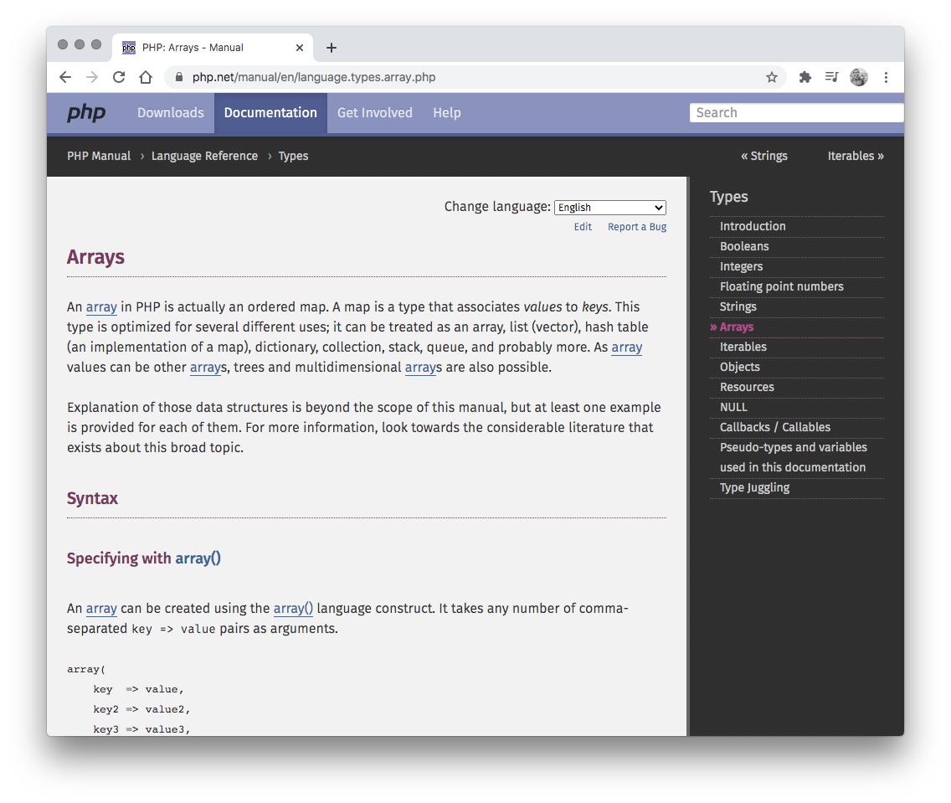
Arrays
PHP variables are used for storing data:
<?php
$people = array(
'Jane',
'Bill',
'Harminder');
$person['first'] = 'John';
$person['last'] = 'Alexander';
?>
https://www.php.net/manual/en/language.types.array.php

Slide 20
Arrays and Forms
PHP form data is stored in an array.
Data from this HTML form:
<form action="form-response.php"
method="post">
First Name:
<input type="text" name="first_name">
<input type="submit" value="Submit">
</form>
Would be stored in this array:
<?php
$_POST = array(
"first_name" => "Jane" );
?>
https://www.php.net/manual/en/tutorial.forms.php

Slide 21
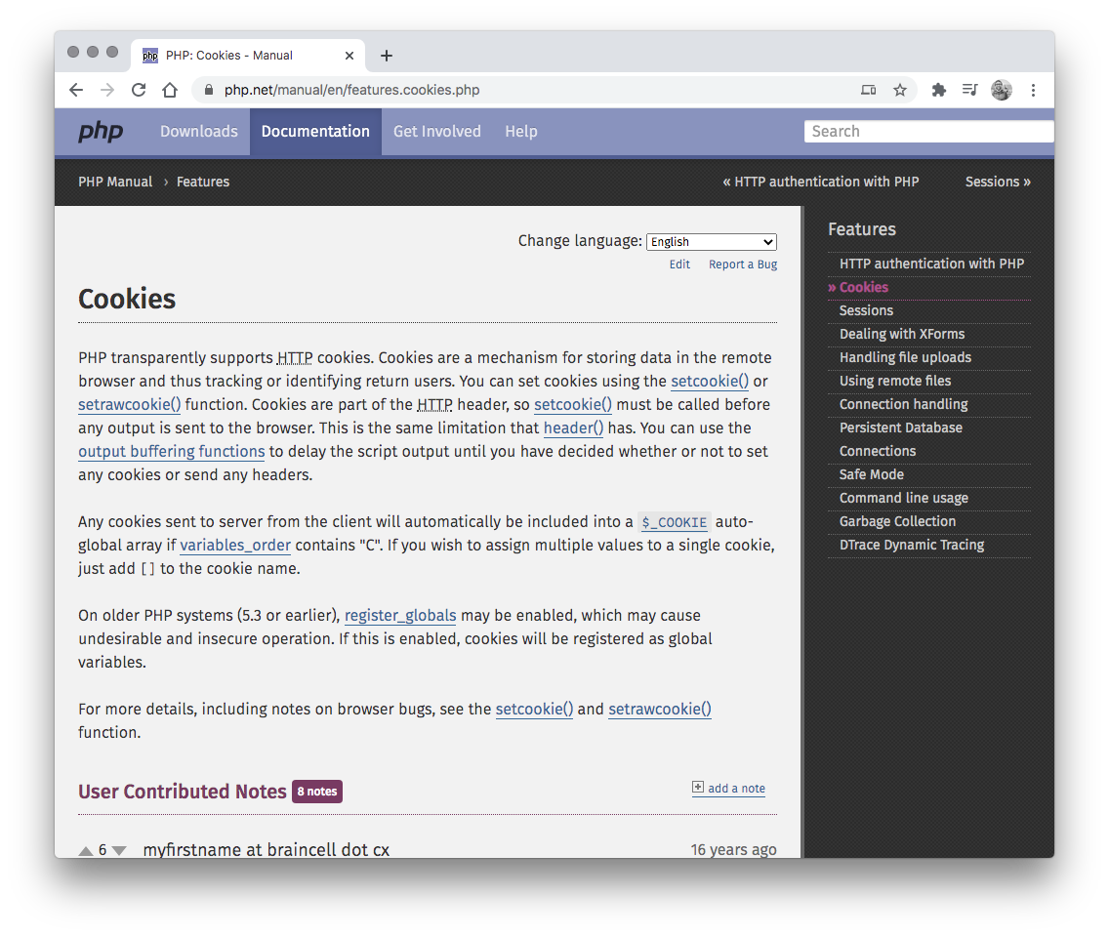
Arrays and Cookies
PHP variables are used for storing data:
<?php
setcookie(
'username',
'value',
time() + (86400 * 30),
'/');
echo $_COOKIE['username'];
?>
https://www.php.net/manual/en/features.cookies.php

Slide 22
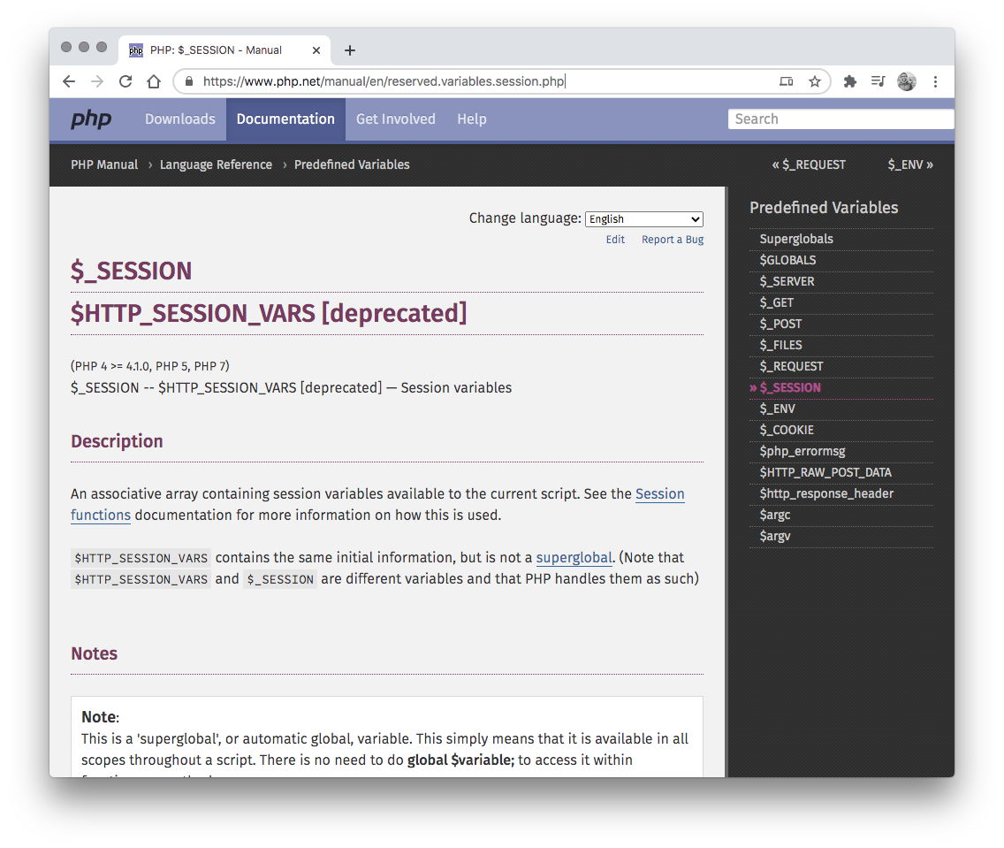
Arrays and Sessions
PHP variables are used for storing data:
<?php
session_start();
$_SESSION['username'] = "user";
?>
https://www.php.net/manual/en/features.cookies.php

Slide 23
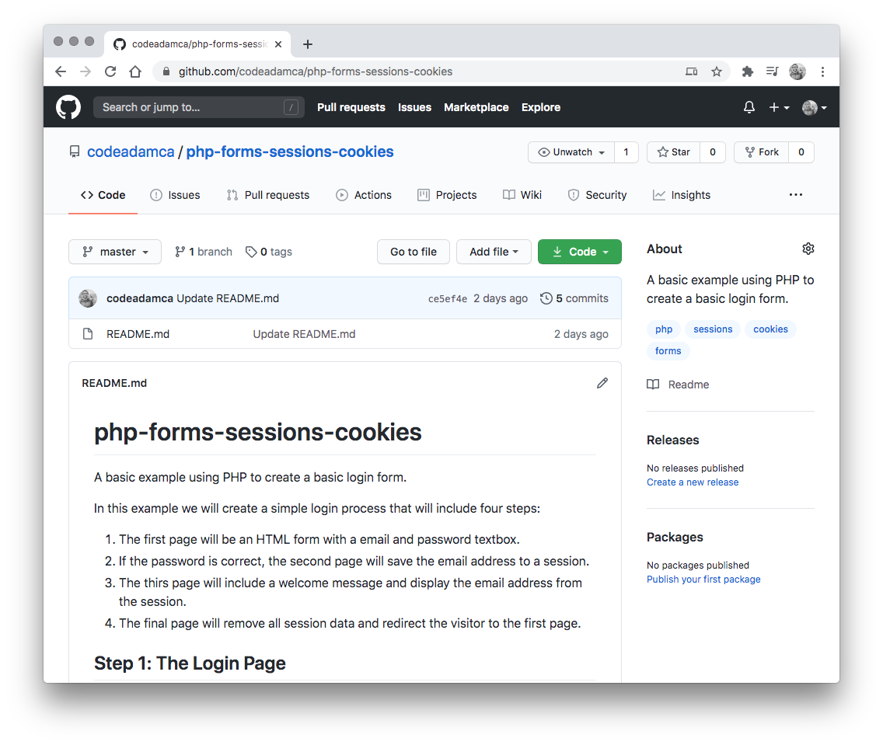
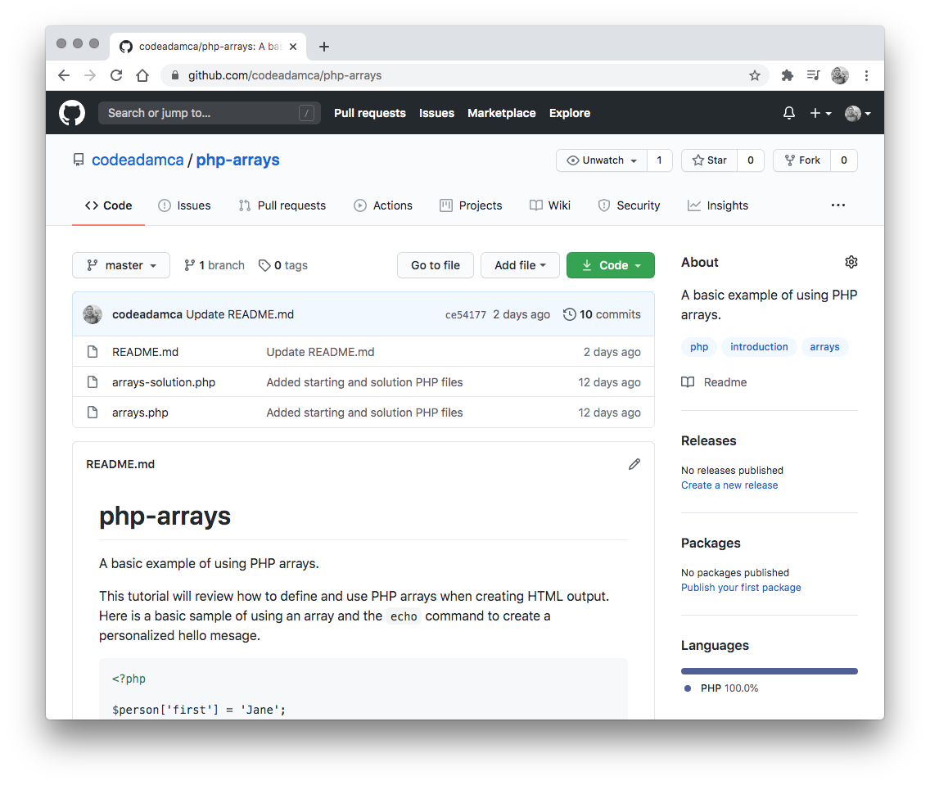
PHP Arrays and Forms Exercises
Follow the arrays and forms exercise on GitHub:
https://github.com/codeadamca/php-arrays
https://github.com/codeadamca/php-forms-sessions-cookies

Slide 24
Goals this Week
1. Understand how to use echo 2. Understand how to use variables and arrays

